Slide 1

Using BIM for Energy-Efficient Renovation
Pierre Bourreau – Nobatek/INEF4
Nathalie Charbel (Nobatek/INEF4) – Madhumitha Senthilvel (RWTH) – Jakob Beetz (RWTH) – Nicolas Bus (CSTB) – Michel Böhms (TNO) – Jyrki Oraskari (RWTH)…

Slide 2
Outline
BIM and Renovation
What are the challenges
BIM4Ren structure
Experiment as much web semantic technologies as possible.
The BIM4Ren data model
Need to model uncertainty – OPM
Need to model building status
Data access – SPARQL/GraphQL-LD/RAMOSE
The conversion process
Based on SWRL rules
Additional features
SHACL checkers
A product of catalogue

Slide 3
BIM4Ren overview

Slide 4

BIM in Renovation
BIM is mainly used on new projects
Need to digitize existing buildings (not just scanning)
Need a suitable model (IFC extension)…
… Usable in the construction & exploitation phases
BIM and Renovation: a complementarity
Can be combined with Energy Audit interventions
Different depths of renovation projects
Different Information for different projects

Slide 5
BIM in Renovation
BIM is mainly used on new projects
Need to digitize existing buildings (not just scanning)
Need a suitable model (IFC extension)…
… Usable in the construction & exploitation phases
BIM and Renovation: a complementarity
Can be combined with Energy Audit interventions
Different depths of renovation projects
Different Information for different projects

Slide 6










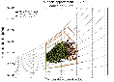


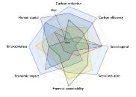

BIM4Ren Concept
Data Management
Data collection
Data- driven design
WHAT IS THE EXISTING DATA ?
Year?
Local regulation?
Cost € ?
Energy performance?
Geometry?
Stakeholders expectations?
Type of occupants ?
Renovation potential ?
State of the existing infrastructure ?
Stakeholders involved in the renovation

Slide 7
BIM4Ren Concept
Digital inputs
Data Management
Data collection
Data- driven design
WHAT IS THE EXISTING DATA ?
To create the BIM model
To organize, consolidate, secure
To validate the BIM model
Stakeholders involved in the renovation

Slide 8
BIM4Ren Concept
Digital inputs
Data Management
Exploit BIM
Data collection
Data- driven design
WHAT IS THE EXISTING DATA ?
To create the BIM model
To organize, consolidate, secure
To exploit the BIM model
Stakeholders involved in the renovation

Slide 9
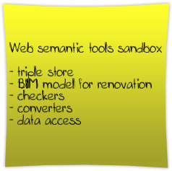
BIM4Ren Concept
Digital inputs
Data Management
Data collection
Data- driven design
WHAT IS THE EXISTING DATA ?
To create the BIM model
To organize, consolidate, secure
To validate the BIM model
Stakeholders involved in the renovation

Slide 10





Deeper view
Catalogue
Conversion SPF to ifcOwl – loading to a triple store
Alignment with BIM4Ren data model
Enrichment from a LD catalogue
Checking information on models
1
3
2
1
ifcOwl
3
2
BIM4Ren DM
4
4
SHACL Checker

Slide 11
The BIM4Ren data model

Slide 12
Goals
Need to model uncertainty
‘the composition of the external wall is certainly brick + Xcm of glass wool’
The scan process has an accuracy of X
Need for modularity
Different type of renovation, different depth of renovation
Models as simple as possible
1
2

Slide 13
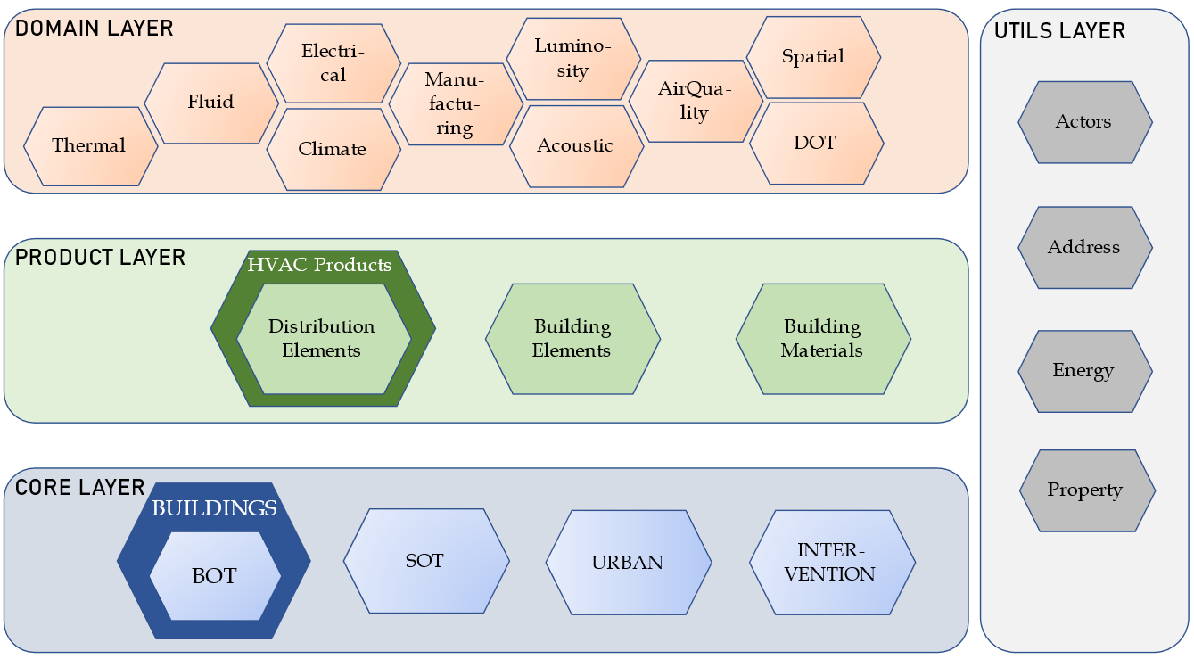
Overview of the data model
https://models.bim4ren.eu
Modularity
Independent ontologies
3 layers (quite similar to IFC layers)
Design pattern through multiple inheritance

Slide 14
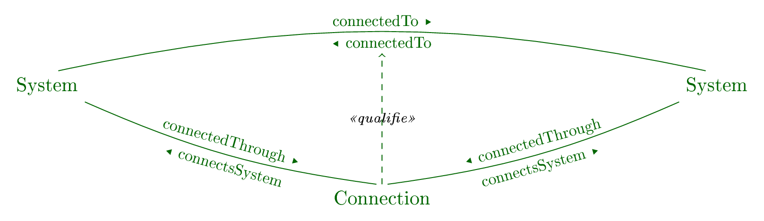
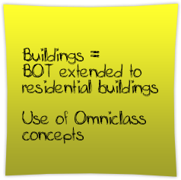
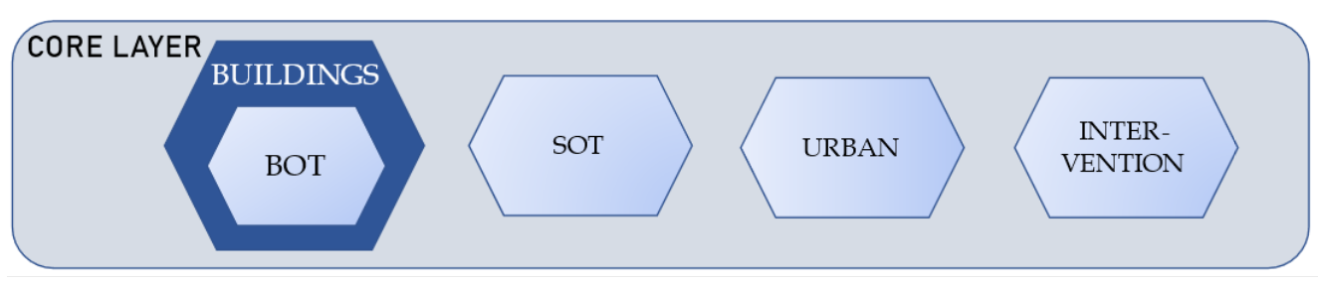

The Core layer
To describe specific aspects of a building, and to attach elements in it according to some specific properties
BOT: Structure of the building Goal: localize elements (‘spatially’)
SOT: Systems/network topology (MEP…) Goal: what is the role of an element within the network?
To which elements is it directly connected?
Intervention: History of intervention Goal: keep trace of works performed (kind, criticality…)
Urban: Elements from the urban context Goal: model external masks, noise, pollution…

Slide 15
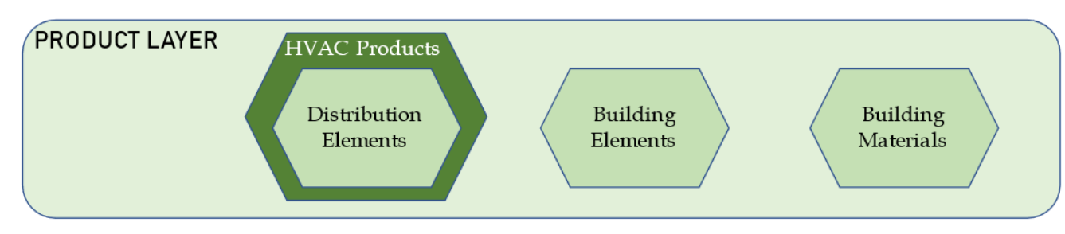

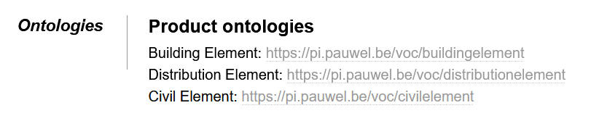
The Product layer
To categorize building products
DistributionElements Goal: categories of products (distribution elements)
BuildingElements: Goal: categories of products (building elements)
BuildingMaterials Goal: categories of materials (for LCA, BEM…)

Slide 16
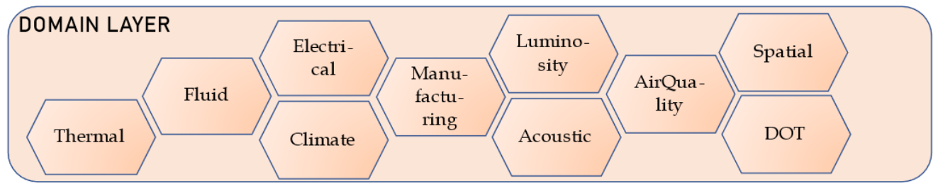
The Domain layer
To associate specific domain properties to elements
Thermal: thermal resistance, solar factor, coefficient of performance…
Fluid: capacity, pressure…
Electrical: nominal power, power in/out…
Manufacturing: brand, product
…

Slide 17
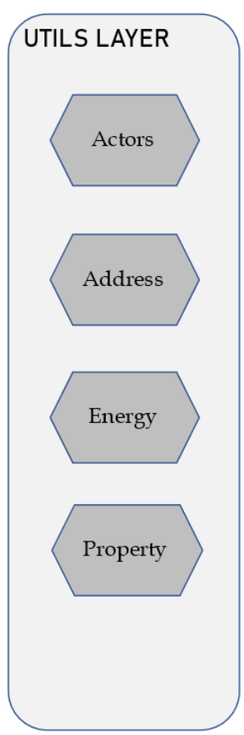
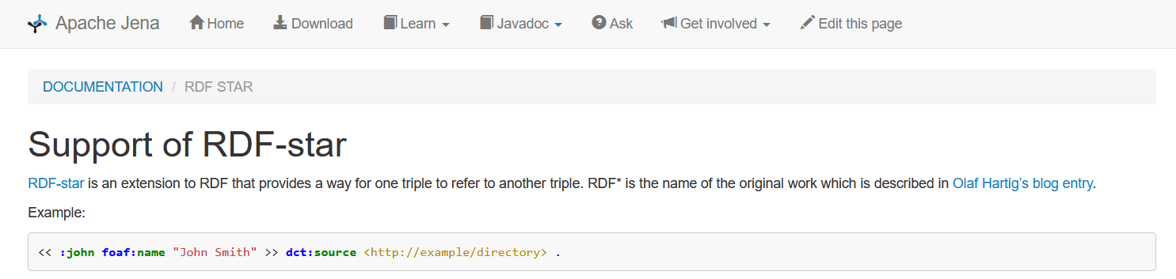

The Property layer
To use concepts that can be transversal to different ontologies
‘Property’: based on SML, work from CEN.
based on QUDT (units, kinds)
similar to OPM level 2 to add some information such as uncertainty.
Limits: uncertainty on relations (‘the insulation material of :Wall#1 may be a rockwool or glass wool’)
Next candidate: RDF*???

Slide 18
Full Modularity
1. What type of product is this?
_:ElectricBoiler#1

Slide 19
Full Modularity
What type of product is this?
Where is it located?
In the building
In my heating network.
_:ElectricBoiler#1

Slide 20
Full Modularity
What type of product is this?
Where is it located?
In the building
In my heating network.
What properties does it have?
For a thermal study
For an electrical study/dimensioning
Geometrical
_:ElectricBoiler#1

Slide 21

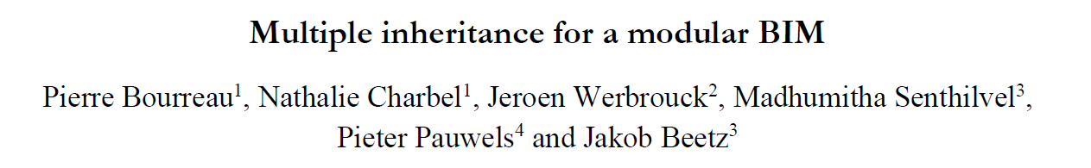
Overview of the data model
Modularity is being discussed in bSI
Can a simple and modelling language-wide mechanism solve it (multiple inheritance)?
The model is product-centric:
Product layer to associate a category
Core layer to associate a building context to the product
Domain layer to get properties (no more Property Sets…)
But frontiers are not always clear…
Need to think of a specific design pattern, understandable and easily implementable…

Slide 22
The conversion process

Slide 23
Why do we need conversion?
Catalogue
Conversion SPF to ifcOwl – loading to a triple store
Alignment with BIM4Ren data model
Enrichment from a LD catalogue
Checking information on models
1
3
2
1
ifcOwl
3
2
BIM4Ren DM
4
4
SHACL Checker

Slide 24
Conversion
IFC is the most common and open standard
We get IFCs from WiseBIM, ARtoBuild (geometry)
But IFC is quite complex => BIM4Ren model
Relations are objectified
Not all properties we want…
Enrich a geometric model with semantic information
CSTB develops POBIM based on ISO23386 - Ontology
BIM4Ren uses SML (CEN to-be standard)
CSTB: POBIM catalogue + ifcOwl
Need to propagate changes on the BIM4Ren DM
ifcOwl to B4R (BOT+) and POBIM to SML

Slide 25

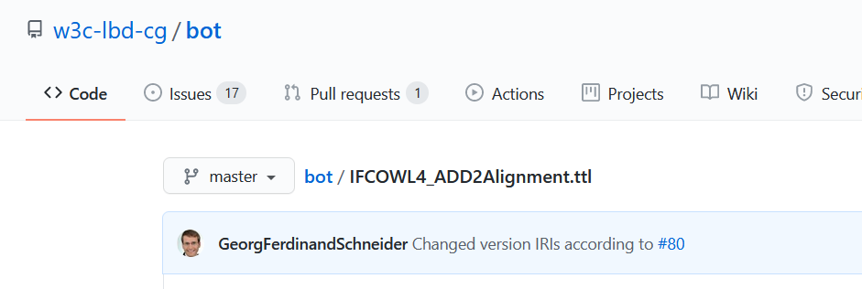
Different options
Static/programmatic conversion
++Can cover all types of elements (geometry, relations…)
--Need save/convert/import procedure on changes
Alignment
++Dynamic in the triple store
--1-1 mapping
--Mostly covers classes, not relations

Slide 26
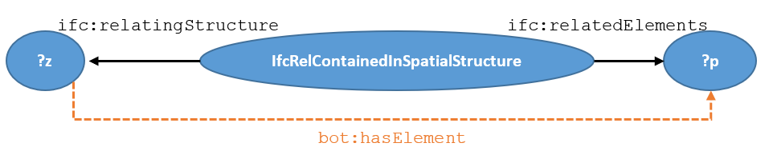
Relation mappings as Inference
IFC relations are objectified
The mapping can be expressed in logic
If ?z is a bot:Zone
And ?z and ?c are connected by an ifc:relatedElements_IfcRelContainedInSpatialStructure relation
=> Then <?z; bot:hasElement; ?p>

Slide 27
Relation mappings as Inference
IFC relations are objectified
The mapping can be expressed in logic
(?z rdf:type ?cl) (?cl rdfs:subClassOf* bot:Zone)
(?c ifc:relatingStructure_IfcRelContainedInSpatialStructure ?z)
(?c ifc:relatedElements_IfcRelContainedInSpatialStructure ?p)
=> (?z bot:hasElement ?p)

Slide 28
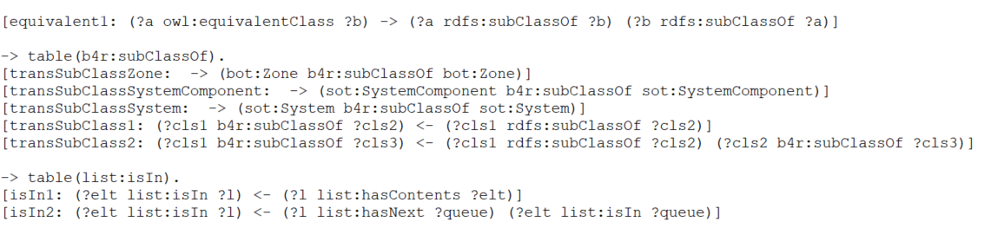
Utility rules

Slide 29
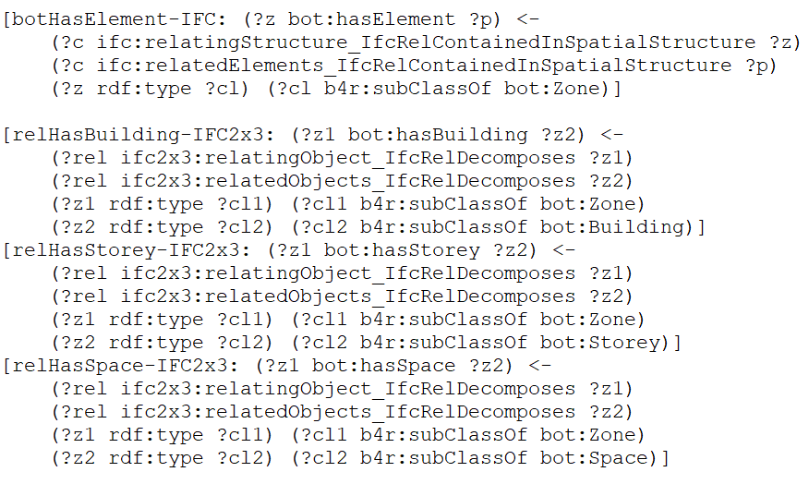
BOT rules

Slide 30
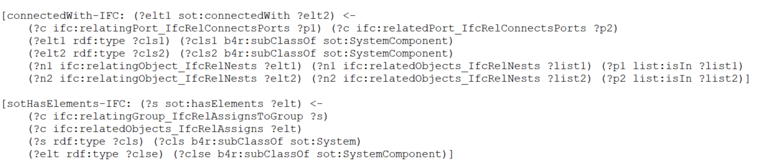
SOT rules

Slide 31
Product layer rules
… + ~750 rules generated with a Python script

Slide 32

Properties

Slide 33

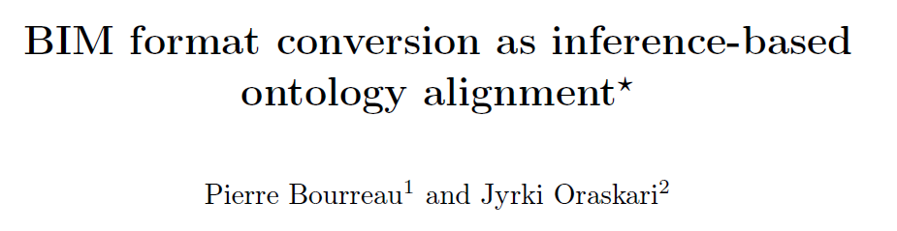
Some thoughts
Multiplicity of ontologies in AEC, need to align them
Already a lot of tools that are native in web semantics (reasoning is one of them)
Conversion is dynamic
Change on the ifcOwl model => reflected in the BIM4Ren data model
Allows one to chose its favorite vocabulary to query the model
Remark on the use of owl:OWLList instead of rdf:List
But no conversion on geometry
BIM4Ren to ifcOwl: more complex (rules are not safe)
Use of makeTemp()

Slide 34
Some more things

Slide 35
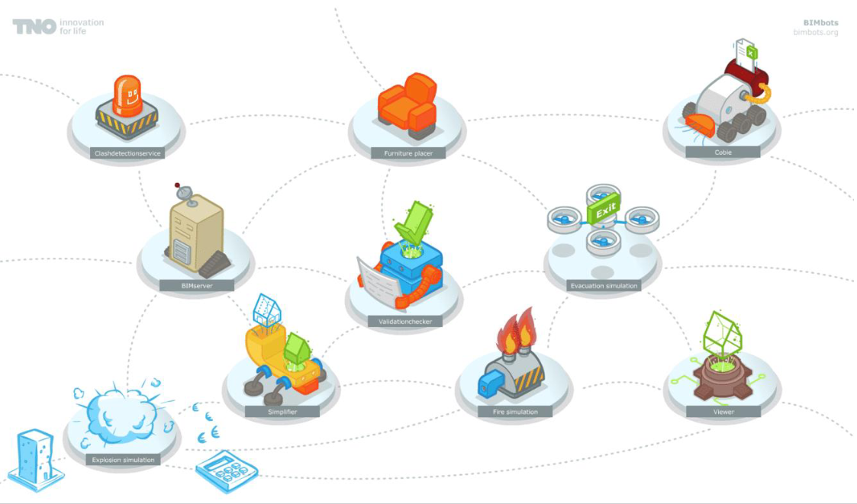


BIM Models checkers
Checkers as (micro) web services
Micro service ≤ Web service
BIM Bots
In BIM4Ren we use SHACL checkers
Semantic web micro services
Semantic BIM Bots
Maestro Bot
Orchestration service

Slide 36

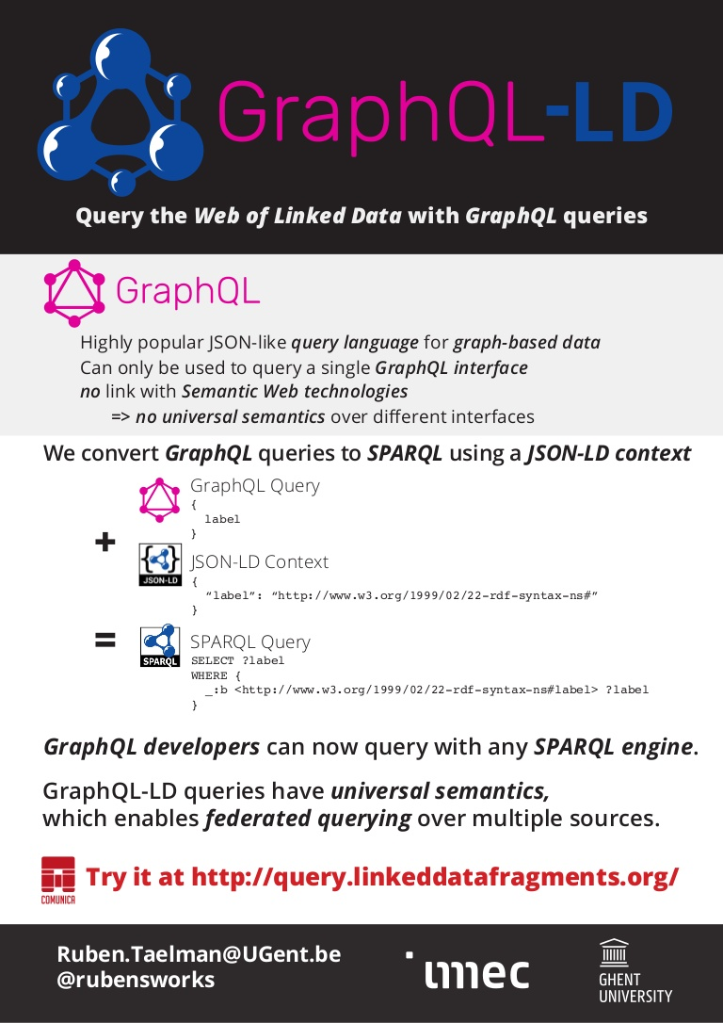

Data access
SPARQL for free
Expert language
0.X% of web service developers know it
REST APIs
Easy to use
Kind of contract between server and client
Need to implement SPARQL Queries… tedious work (no ORM)
GraphQL-LD
JS at either client of server
Restricted to queries (no edition) – still?
Kind of another expert language
RAMOSE
Ease the deployment of REST APIs on top of SPARQL
Also restricted to Get
Need more work and contributions

